Slide 1
Elul Technologies Ltd.
Your Partner for the Defense & Aerospace Industries
www.elul.com

Slide 2
Corporate Structure

Slide 3
Group Management
BG (Ret) Avner Raz
Group Chairman, CEO & President
Shiran Lahav Group CFO
BG (Ret) Kuti Mor
VP Business Development
Ayelet Inav-Ripstein
VP Legal
Nissim Shaul
President & CEO
New Technology Ltd.

Slide 4
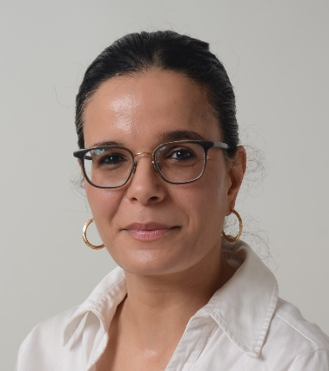
Shiran Lahav-Nidam Group CFO
2014-present - CFO
2003 - Joined Elul as Comptroller
2000-2003 - CPA at Kost, Forer, Gabbay & Kasierer (Ernst & Young)
2003 - MBA, with honors, from Ben-Gurion University
2001 - CPA
1998 - BA in economics and accounting, Ben-Gurion University
1976 - Born in Israel, married to Shimon, mother to Abigail and Tamar

Slide 5
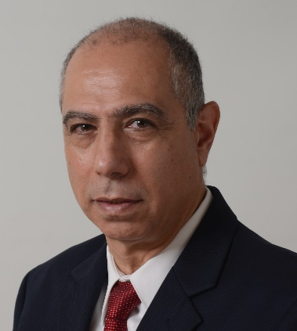
Nissim Shaul President & CEO New Technology SK Ltd.
2008 - Joined Elul as President & CEO of New Technology SK Ltd., following the acquisition of the company by Elul Tamarynd Ltd.
2003 - Mr. Shaul co-founded New Technology SK Ltd. and held the position of its Managing Director.
1998 - established NS Consultant Services.
Previously held positions of Director of Sales, Sales Manager, Service Manager and Service Engineer for laser systems and scientific research equipment at Isramex Ltd.
1962 - Born in Ramla, Israel, married to Orly, father to Zach (1989), Gal (1992) and Raz (1996)

Slide 6
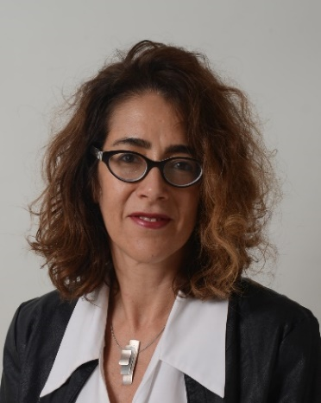
Ayelet Inav-Ripstein VP Legal & General Counsel
2013 - Joined Elul as VP Legal & General Counsel; member of the Israeli Bar since 1993.
1994-2013 - Associate and partner, Gornitzky & Co. law firm.
Over the years - 1993-2013, pursued a distinguished career in law, focusing on commercial, corporate, civil, infrastructure and real estate (1994-2013), Head of Legal department of Hotels.
1993 - LLB from Tel Aviv University, Faculty of Law, magma cum laude, 2015 MBA, Marketing from Ono Academic College, summa cum laude.
1968 - Born in Israel, married to David, mother to Roey, Shir and Dana

Slide 7
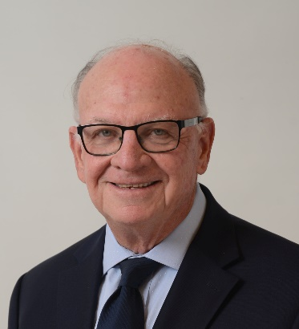
Kuti Mor Executive VP Business Development CEO AIMS Ltd.
2011 - Joined Elul as VP Business Development following a long and distinguished career in the IDF and Ministry of Defense.
Former MOD Deputy Director General and Head of its Rehabilitation Div.; MOD Chief of Staff; Head of MOD NY Purchasing Mission; MOD representative to the US Departments of Defense and State.
1992 - Retired from his active service in the IDF Intelligence Corp. at the rank of Brig. General; Deputy Director of IDF Military Intelligence; Military Secretary to Defense Ministers Rabin and Arens; Commander, IDF Liaison Unit to Foreign Forces.
1970 - B.A. from Tel-Aviv University in Middle Eastern Studies; professional and academic courses in management and business law.
1946 - Born in Haifa, Israel, married to Hella with 3 children, Elad (1970), Ifat (1973) and Doron (1980)

Slide 8
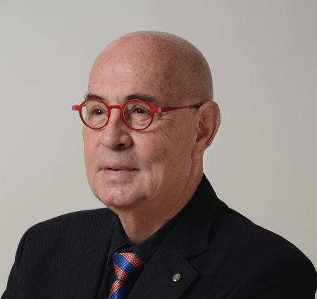
Avner Raz
Chairman, CEO & President Elul Technologies Ltd.
2020-present – Chairman, CEO & President
2010-2020 - President of Elul Tamarynd Group
2007-2010 - Chairman of the Board of Israel Military Industries Ltd. – IMI
2003-2006 - President & CEO of Lumenis, a global manufacturer of laser, light and RF for medical and aesthetic instrumentation.
1994-2003 - President & CEO of Elisra, Israel’s electronic warfare manufacturer.
1990-1994 - served as President of the Bedek division of IAI – Israeli Aerospace Industries, dealing in upgrade and maintenance of military and commercial aircraft.
1990 - Raz retired from the Israeli Air Force as the Head of Material Directorate at the rank of Brig. General.
1982 - MSc. in Systems Engineering and Economics from Stanford University, US.
1967 - BSc. in Electronics Engineering from Technion, Haifa, Israel

Slide 9
Elul Technologies Management
BG (Ret) Avner Raz
Chairman, CEO & President
BG (Ret) Kuti Mor
VP Business Development
Amiad Segal
VP Sub Systems & Components
Gil Har Zion
VP Advanced Systems
Many Gerskovich VP Engines & Mechanical Systems
Zvika Tsoran
VP Land Systems

Slide 10
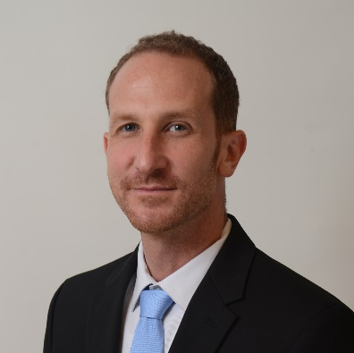
Amiad Segal
VP Subsystems & Components Elul Technologies Ltd.
2020 – Joined Elul-Technologies Ltd. Business Development Subsystems & Components Division. Since 2021, Amiad is the VP of this division, spearheading its business development efforts with a focus on strategic partnerships and customer relations.
2015-2020 - HP Inc., Project and Product Management wide printing division, Scitex, in charge of foreign strategic partners operational aspects on the C500 project.
2006-2015 - IAF, served on operational and staff technical leadership roles in the fields of Communication, Navigation, EW, and C5I.
2009 - B.Sc. in Electrical Engineering, Technion - Israel Institute of Technology
1983 - Born in Israel, Haifa, widowed from Liat

Slide 11
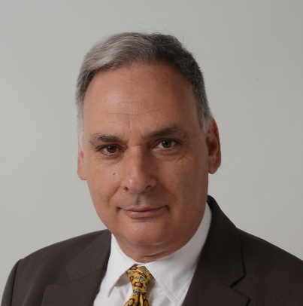
Gil Har-Zion VP Advanced Systems Elul Technologies Ltd.
2000 - Joined Elul and served as VP Information & Communication Systems until 2010, when he expanded his role to become VP Advanced Systems.
Formerly – engaged in IAF advanced communications systems; large-scale procurement, R&D programs and budgetary allocation; section head in the Intelligence Research Dept.
At the Technion Jet Propulsion Laboratory in the 1980s, was a member of a research team studying advanced thrust-vectored UAV concept for a leading U.S. aerospace firm; team member of IAI Kfir improvement project.
1993 - M.B.A. in Finance from Tel Aviv University Recanati School.
1988 - Graduate of the IDF Officers Academy.
1987 - BSc, with honors, in Aeronautical Engineering from the Technion.
Currently, Gil is involved in the electronics, advanced systems, optronics, sensors and intelligence domain, contributing to development of Elul’s business and expansion of the company’s customer base, both domestically and worldwide.
1965 - Born in Savyon, Israel, father to Shira (2001), Yoav (2007) and Ariel & Dan (2009)

Slide 12
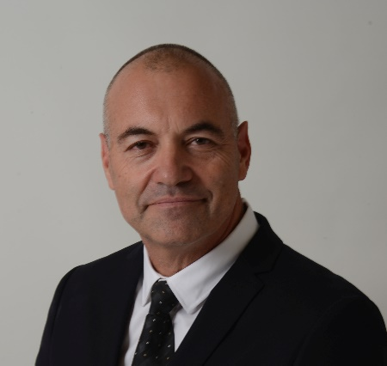
Zvika Tsoran VP, Land Systems Elul Technologies Ltd.
2022 – Zvika Tsoran joined Elul Technologies Ltd. as VP Land Systems
2019-2022 – Head, Firefighter & Rescue Academy of Israel
2015-2018 – Brigade Commander of Haifa District Home Front Command Unit, IDF
2011-2015 – Deputy Commander of 91st Division, IDF; 2013-2015 – Commander of the College of Command and Staff, IDF
2008-2011 – Head of Department, Training & Development, GFC; Commander of Armor Reserves Brigade, IDF
2022 – Wexner Senior Leaders Program, Harvard University; 2013 – Directors & Senior Executives Program, School of Directors & Finance; 2006-2007 – MA, Military & Strategy, AWC, Carlisle, PA; 2000-2002 – BA, Human Resources Manager, Ben Gurion University, Israel; 1999-2000 – Command & Leadership course, College of National Security, Israel

Slide 13
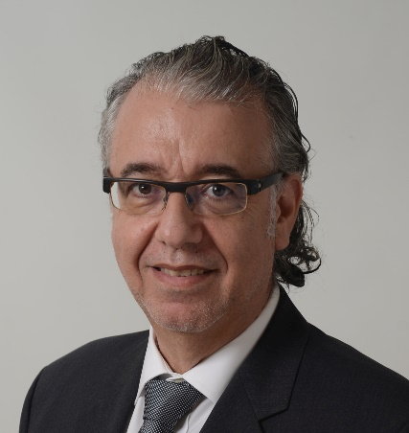
Many Gerskovich VP Engines & Mechanical Systems Elul Technologies Ltd.
2010-Present -Joined Elul following 24 years of service in the IAF – Israeli Air Force, and MOD NY Purchasing Mission. Retired as Lt. Col. Accumulated extensive experience in engineering, operating, maintenance, logistics, procurement and commercial activities relating to airborne platforms and mechanical systems. Played key role in the procurement process, development and implementation of the F16I (Storm) and the Apache Longbow.
Served as IAF Head, Mechanical Branch, Engineering Wing; responsible for all mechanical systems of the IAF airborne platforms; Head of Transportation Branch, responsible for safety and availability of C-130, B707 & B200 fleets.
In his last assignment with the IAF, served as Director of Aircraft Programs and Air Force Procurement at the MOD NY Purchasing Mission.
EMBA from Beer Sheva University (1997) and B.Sc. Mechanical Engineering from Tel Aviv University (1989)
1961 - Born in Israel, married to Rivka, father to Naama (1995), Nadav (1995) and Tamir (2001)

Slide 14
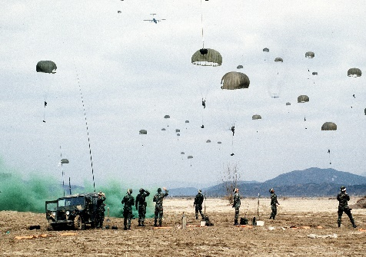
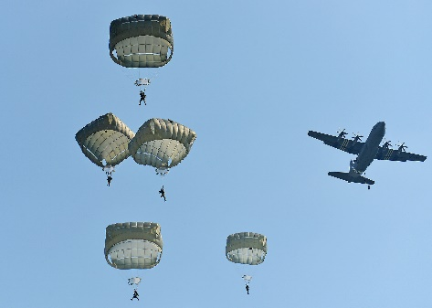
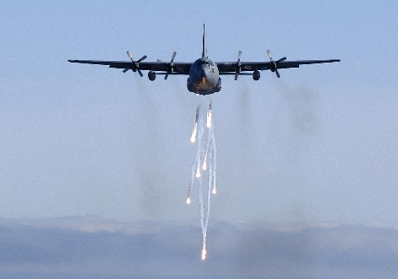
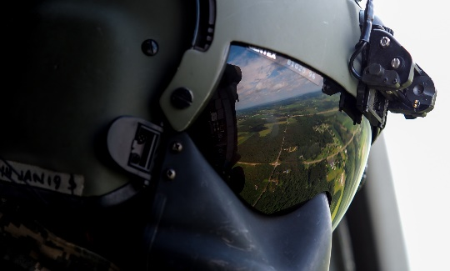
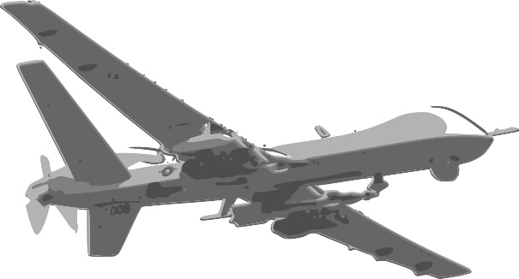
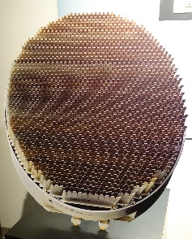
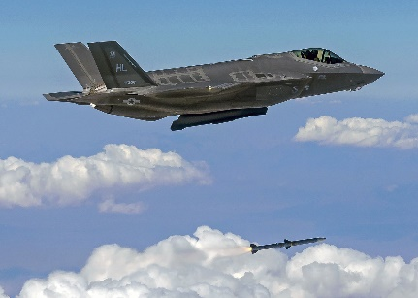
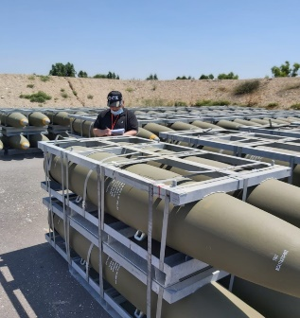
Characteristics
Israel’s premier technology, marketing & consulting company
Engineering and TechnoLogistics Service provider for multinational manufacturers
Established in 1973
TRACE certificated
Registered broker at the US Department of State
Israel MOD DECA (Defense Export Controls Authority) Certified Defense Exporter
ISO 9001 | 2015 Certified

Slide 15
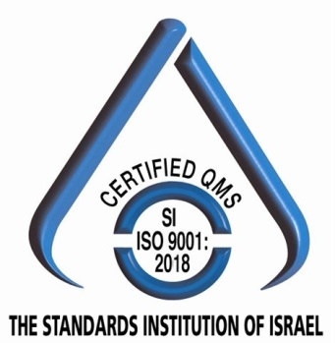
Professional associations
TRACE
Certified (Anti-Bribery Compliance Essentials)
(ITAR)
International Traffic in Arms Regulations compliance
Israel MOD DECA
(Defense Export Controls Authority)
Certified Defense Exporter
US Department of State registered broker
ISO 9001 | 2015
Certified

Slide 16
Elul Technologies Values and Reality
Quality of service - A unique team of experienced professionals covering the whole local defense and aerospace market
Ethics - Flawless business conduct for over 40 years augmented by internal compliance program
Value for money - Elul Technologies network and staff, being a force multiplier, ensures the best use of the foreign principals’ time, money and resources while meeting their goals
A complete solution – Elul Technologies is active on every level of promoting business in question – from the lowest working echelons up to top executives and decision makers wherever needed

Slide 17
Range of Services
In-country & international business development, marketing, consulting, trade & management
TechnoLogistics| outsourcing management| after-sale support| ILS - integrated logistics services| CLS
Offset-related solutions and industrial cooperation
Major campaign strategies and implementation
Engineering services

Slide 18
Mode of Operation
Our vast experience working with leading defense sector companies around the world gives us a unique approach to strategic planning and execution of large scale projects
Ability to translate trends, indicators and information, to impact decision-making process
Early stage identification of new opportunities
On-target response
Timely recommendations to achieve better results

Slide 19
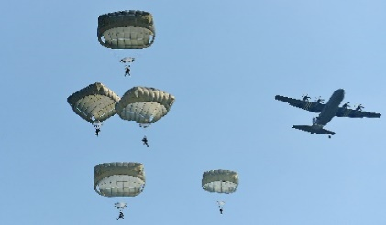
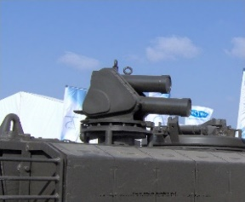
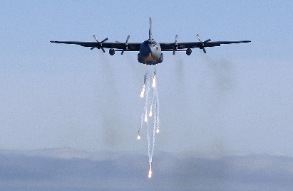
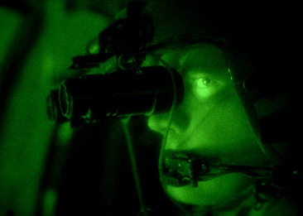
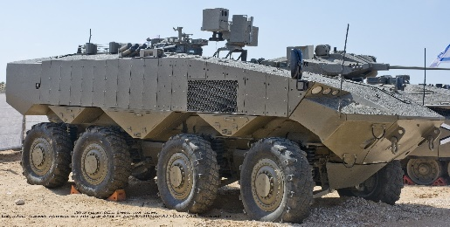
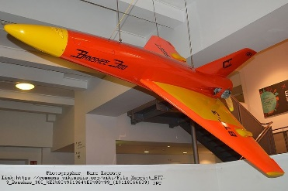
Elul Technologies Ltd
Elul technologies was established in 1972 and as of 2019 is a wholly owned subsidiary of AVRAZ Consulting Ltd., providing complete solutions and services to multinational companies and manufacturers.
As Israel’s premier technology, consulting and marketing company in the Defense & Aerospace industry, we offer our clients with a comprehensive range of solutions and services; Business development, marketing & sales, outsourced project management, technical and engineering services, pre and post-sales support, program management and ILS (Integrated Logistics Services), both locally and internationally.
Our team consists of highly qualified, knowledgeable and experienced professionals, working with our clients worldwide. From the planning phase to a successful completion, we guarantee top quality results.

Slide 20
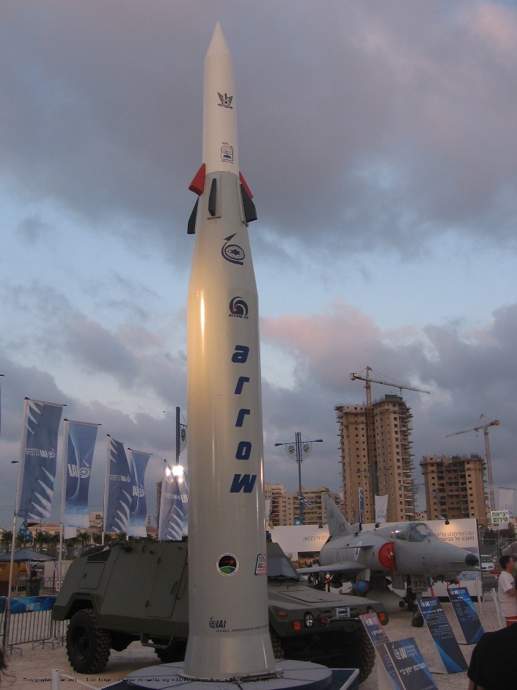
AIMS (Industrial Collaboration)
AIMS assists American and other international companies with industrial cooperation commitments in Israel, locate Israeli companies that know how to manufacture and supply products and equipment that meet the requirements of American and other companies.
For instance, AIMS assisted GD LAND SYSTEMS, with its high scope of industrial cooperation obligations, to locate the Israeli companies that could take part in the program.
AIMS also assist Israeli companies with obligations of industrial cooperation abroad, to locate manufacturers overseas who know how to meet their requirements.
AIMS is also responsible for the planning, managing and implementation of business opportunities, related to the export activities of Israeli security companies to various countries abroad.

Slide 21
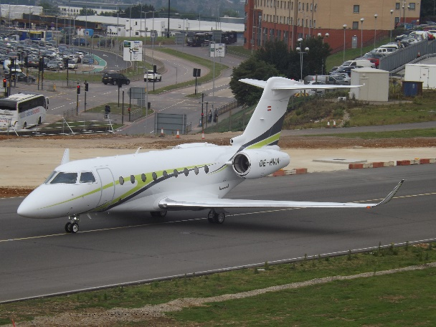
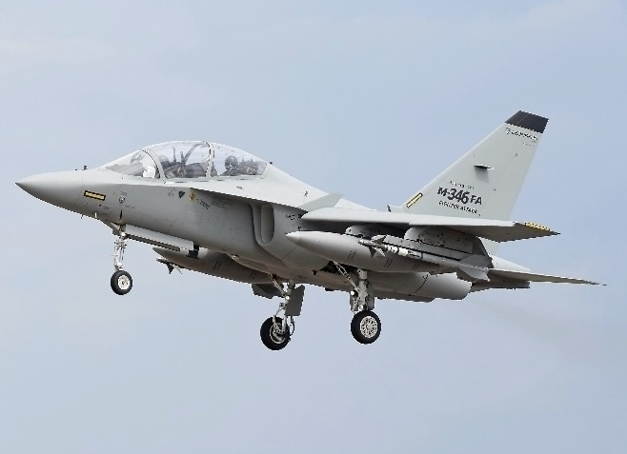
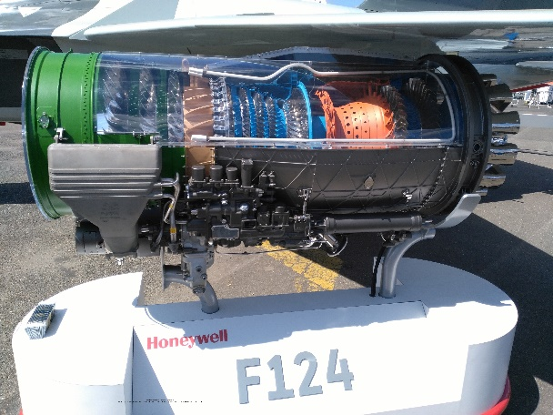
Taldor Engineering Services Division
Taldor Engineering Services has been the driving force of every program management and after-sale services executed by Elul Technologies subsidiaries
Taldor Engineering Services covers every aspect of program management: Project development and coordination, selection and monitoring of subcontractors, QA, and QC, coordination of technical teams, customer liaison, after-sales field services, integrated logistics support and administration
At Taldor Engineering Services, we are channeling our many years of experience in the defense industry, to the benefit of our principles and their customers

Slide 22
New Technology S.K.
A high-end representative of leading worldwide manufacturers of lasers, optics, electro-optics and opto-mechanical products for industrial market and research centers
Providing pre- & post- sales, technical service and applications support
Customer-oriented representative company
New Technology has a wide offering of products, including a variety of lasers, laser diodes, light sources, motion control systems, vibration isolation tables and systems, photo detectors, optical and opto-mechanical components, electro-optics instrumentation, optical and opto-mechanical sub assemblies, high-sensitive cameras, optical fibers, AFM nanolithography systems, power supplies for lasers and light sources, accusto-optical modulators, galvo scanners and components for optical communications

Slide 23
Elul Technologies – Major Principals

Slide 24
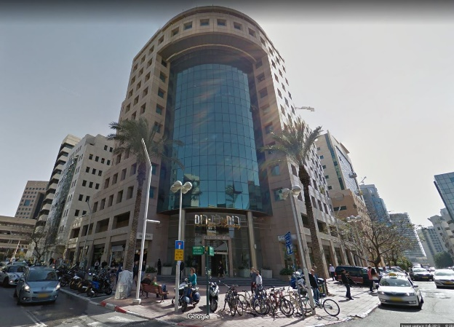
Contact:
Israel Office:
11 Tuval Street
Ramat Gan 5252226, Israel
Tel. +972 (3) 753-7777
Fax. +972 (3) 753-7700
Email:
elultech@elul.com
24

Slide 25
Your Partner for the Defense & Aerospace Industries
www.elul.com

